Slide 1

AngularJS
$resource

Slide 2
AngularJS
$resource
A factory which creates a resource object that lets you interact with RESTful server-side data sources.
The returned resource object has action methods which provide high-level behaviors without the need to interact with the low level $http service.
Requires the ngResource module to be installed
https://docs.angularjs.org/api/ngResource
Then, include angular-resource.js in your HTML:
<script src="path/to/angular.js"></script>
<script src="path/to/angular-resource.js"></script>
Finally, load the module in your application by adding it as a dependent module:
angular.module('app', ['ngResource']);

Slide 3
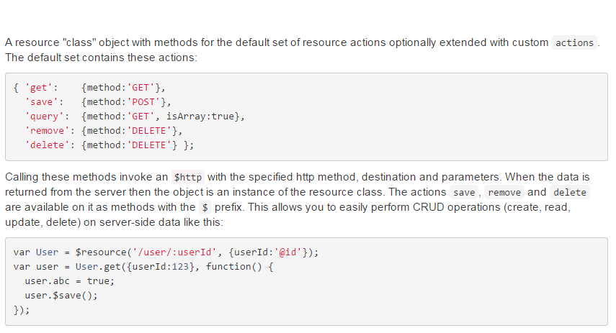
AngularJS
$resource

Slide 4
AngularJS
$resource
Invoking a $resource object method immediately returns an empty reference (object or array depending on isArray).
Once the data is returned from the server the existing reference is populated with the actual data.
This is a useful trick since usually the resource is assigned to a model which is then rendered by the view.
This means that in most cases one never has to write a callback function for the action methods.

Slide 5
AngularJS
$resource
The action methods on the class object or instance object can be invoked with the following parameters:
HTTP GET "class" actions: Resource.action([parameters], [success], [error])
non-GET "class" actions: Resource.action([parameters], postData, [success], [error])
non-GET instance actions: instance.$action([parameters], [success], [error])

Slide 6
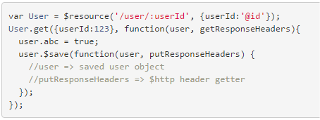
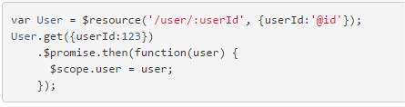
Using callbacks
$resource
With callback
Using $promise

Slide 7
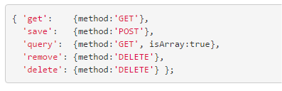
How to update an element with $resource?
$resource
There is no PUT or PATCH method!
Why?
Different backends got different opinion on the HTTP verb being used for update: PUT, POST or PATCH
How to identify the item to update?

Slide 8
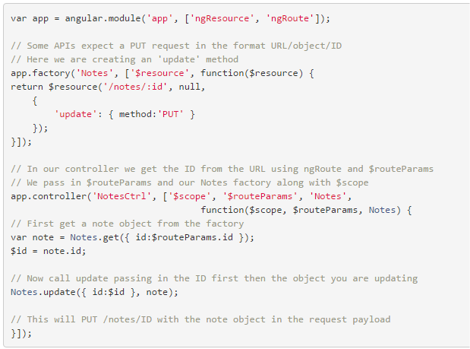
How to update an element with $resource?
$resource
Everybody have to create his own update method, for exemple:

Slide 9
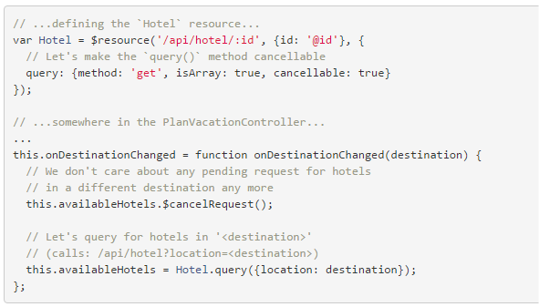
Cancelling requests
$resource
If an action's configuration specifies that it is cancellable, you can cancel the request related to an instance or collection (as long as it is a result of a "non-instance" call):

Slide 10
TP
$resource
Le but du TP est d'utiliser le service $resource pour faire interagire l'application avec le backend
Instructions
Importer le module angular-resource :
Embarquer bower_components/angular-resource/angular-resource.js dans l'index.html
Injecter le module ngResource dans l'application
Déclarer une resource Todo dans le controller
Créer une fonction qui charge la liste ds taches en utilisant la resource Todo
Modifier la fonction d'ajout de tache pour poster la nouvelle tache au backend
Modifier la fonction de suppression de tache pour supprimer la tache du backend
Modifier la fonction de modification d'une tache pour reporter la modification dans le backend

